Slide 1
KCSE DATA ANALYSIS
Analysis of a KCSE DataSet for the KamiLimu Data Science Track.

Slide 2
Possible Data that could be gotten from the Dataset
Our group deduced that the following could be deduced from the dataset:-
Has performance improved or declined?
Has the no. of candidates increased or decreased?
What is the difference between male and female performance?
Has the gap in gender difference increased or decreased?
How do quality grades(A-C+) compare to non - quality grades(C-E) ?
What is the trend seen from the data over the years?
What is the most common grade(mode), mean?...
These were used as the basis of our analysis

Slide 3
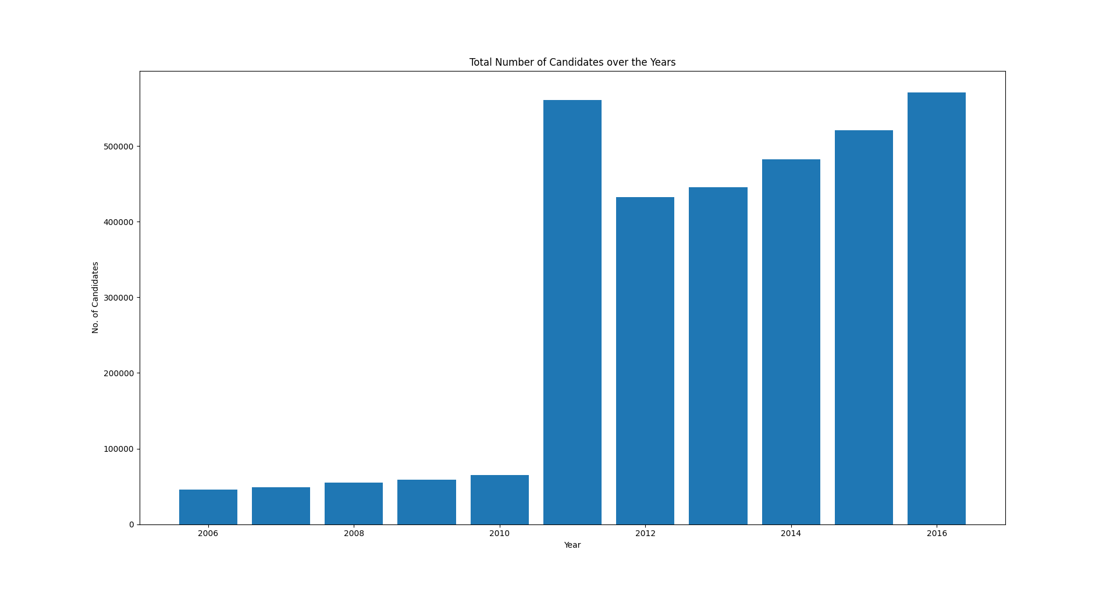
Findings
The total number of candidates increased over the years.
In 2015, there was the least gap between quality grades and non-quality grades
2016 had the lowest percentage of quality grades.
Over the years, only 24.54% of students achieved quality grades while 75.46% failed to qualify for University.

Slide 4
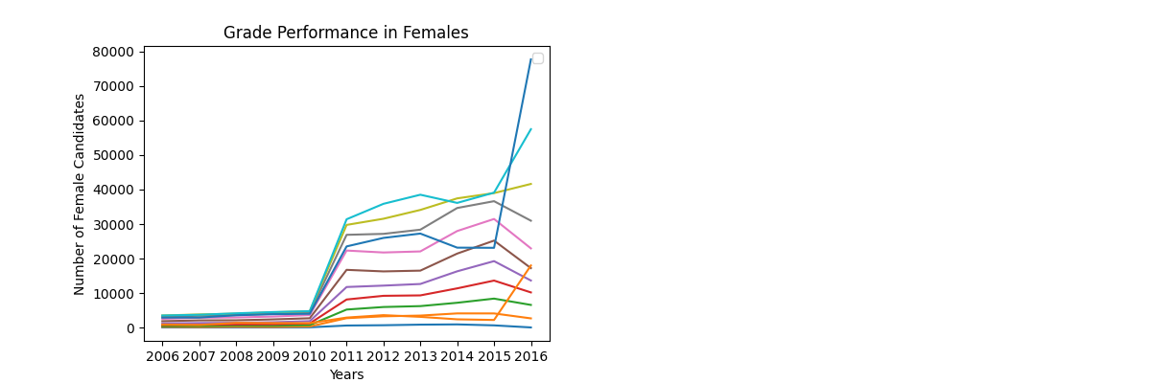
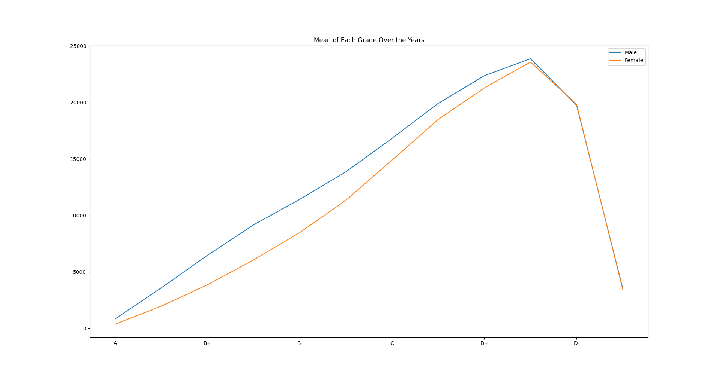
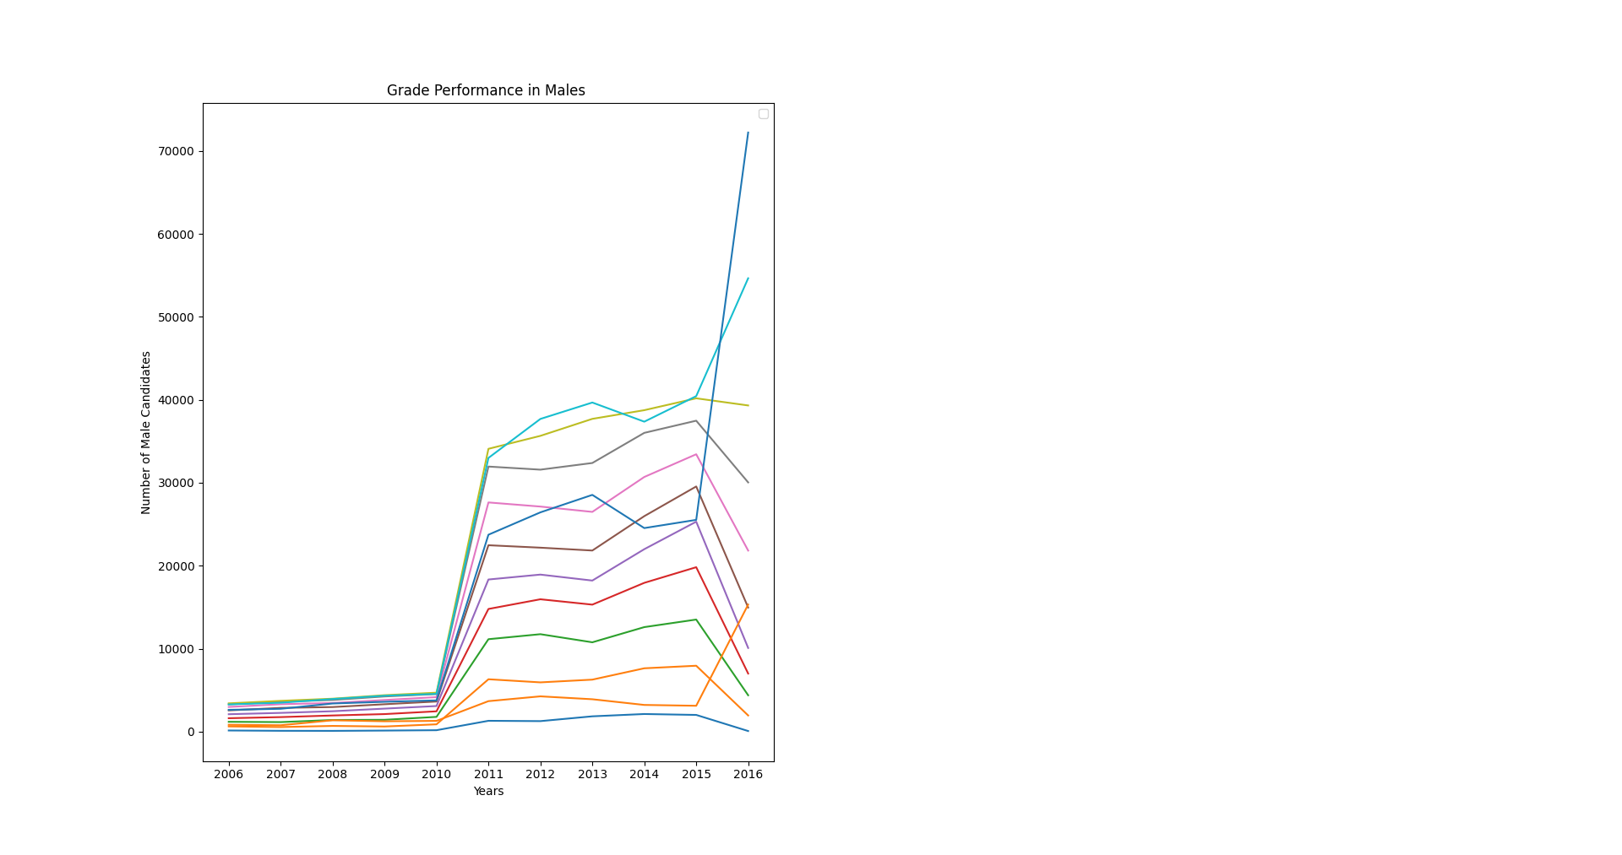
Comparison of grades between males and females
The most common grade among males over the years was D+ and D among females.

Slide 5
The Full Report can be found here: https://github.com/Adrian-Silver/KCSE-Data-Analysis

